Slide 1
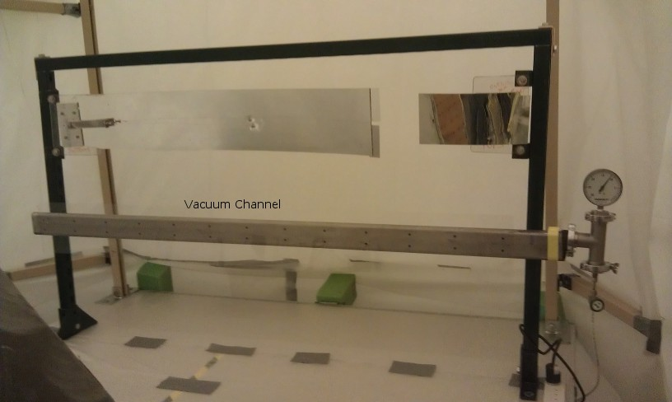
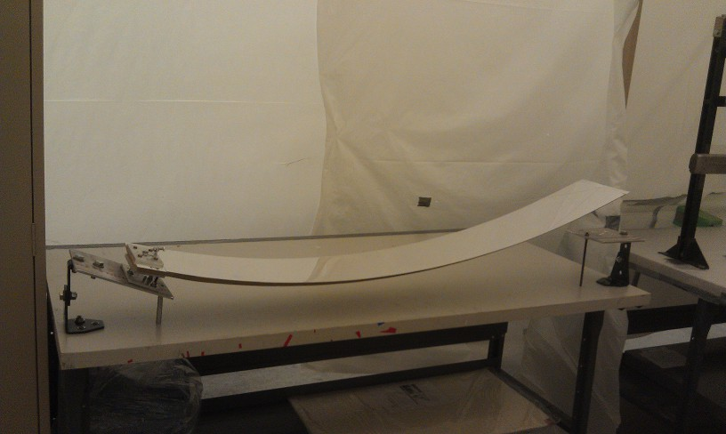
LTCC Calcom
M. Ungaro
Project Status:
Mirrors Re-coating Started
PMTs testing/refurbishing Started
Box Back-wall production Started
System Checkout
Mirrors Saggin Test
Gas System refurbishment
Mirrors alignment
Window Installation
HV matching
Commissioning:
SPE calibration, with and w/o beam
Effect of torus field on SPE
Top: holding fixtures for mirror, lexan strips glue application.
Bottom: mirror support for applying lexan strip
Notes:
Questions and Answers

Slide 2
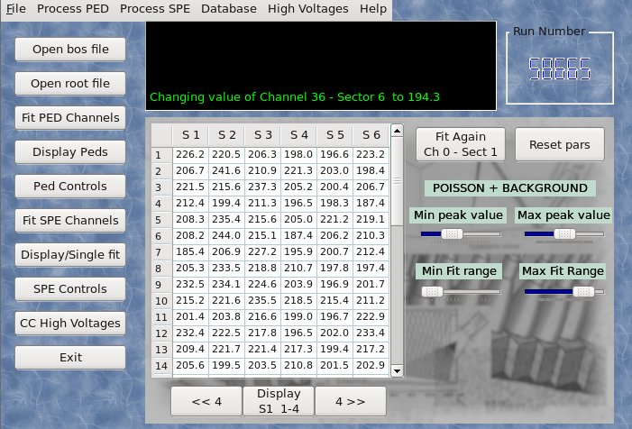
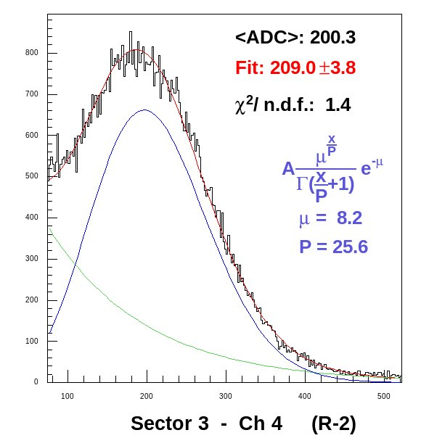
LTCC Calcom
M. Ungaro
Calibration Team
M. Ungaro
A. Puckett
N. Markov
Plans:
HV i/o
Database (CCDB) i/o
Graphical Interface
SPE identification
CC timing
Most software common to LTCC/HTCC
Status
Work just started
Clas6 software can be used as basis
Top: clas6 GUI to be used as basis for clas12 software for LTCC/HTCC
Bottom: an example of SPE fit with general poissonian + exponential
Notes:
Questions and Answers

